Slide 1
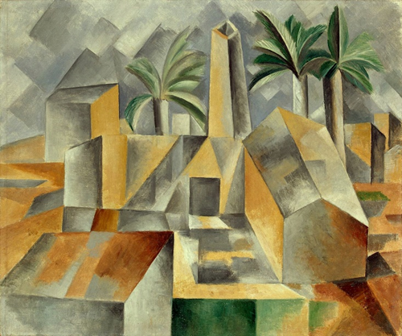
CUBISM
Early 20th C.
Avant-Garde Movement
History of Modern Art
BFA-III (Visual Arts)
Course Incharge: Ms. Sidra Liaqat
Institute of Design & Visual Arts, LCWU
Pablo Picasso

Slide 2
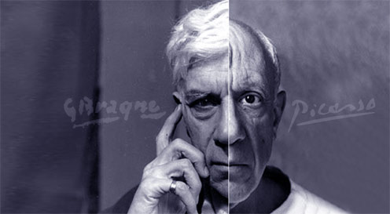
Georges Braque
(1882 – 1963)
France
Pablo Picasso
(1881 – 1973)
Spain - France

Slide 3
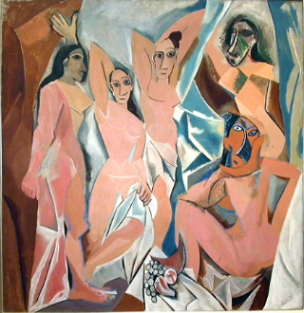
PABLO PICASSO
“Les Demoiselles d'Avignon” (1907)

Slide 4
The inspiration for the Cubists comes from the theory of the Post-Impressionist painter Cezanne i.e.,
“Treat nature in terms of the cylinder, the sphere and the cone, everything in proper perspective …” (Protter, 1997, p. 136).
Picasso says, “I paint forms as I think them, not as I see them.”

Slide 5
Breaking down
Decomposition
Deconstruction
Disintegration
Dissection
Distortion
Fracture
Fragmentation
Splitting
of the component parts of an object, so that it depicts different views of the same object from different angles.

Slide 6
The forms are analyzed, decomposed and then recomposed.

Slide 7
Cubism consists of two phases.
Analytic Cubism
Synthetic Cubism

Slide 8
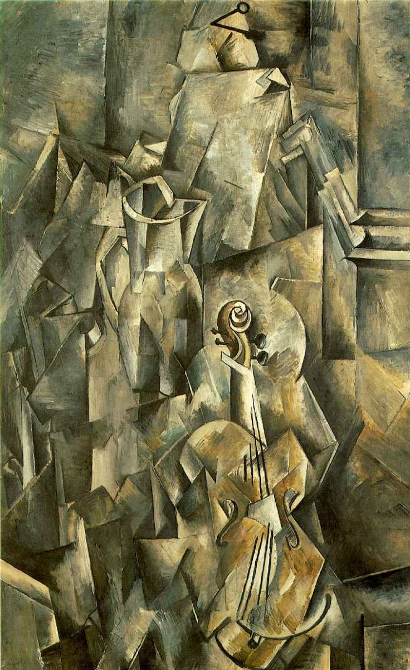
ANALYTIC CUBISM
GEORGES BRAQUE
“Violin and Jug” (1910)

Slide 9
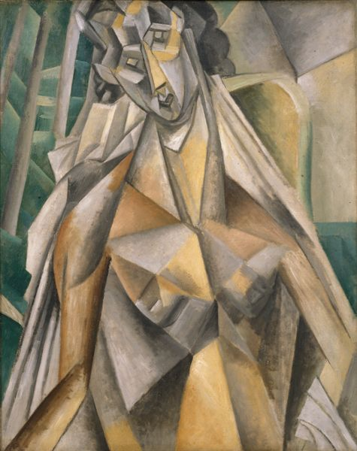
PABLO PICASSO
“Nude in an Armchair” (1909)

Slide 10
PABLO PICASSO
“Portrait of Ambroise Vollard” (1910)

Slide 11
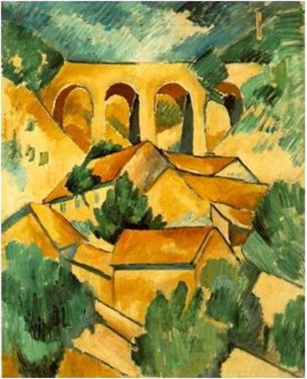
GEORGES BRAQUE
“Viaduct at L'Estaque ”
(1908)

Slide 12
GEORGES BRAQUE
“The Portuguese” (1911)

Slide 13
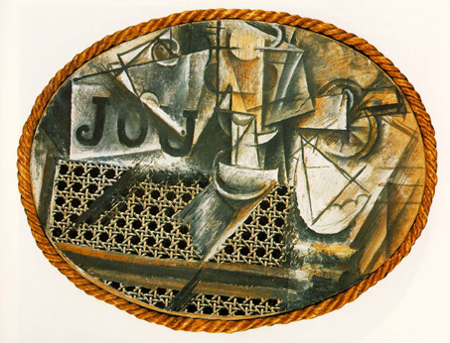
SYNTHETIC CUBISM
PABLO PICASSO
“Still Life with Chair-Caning” (1912)
[Oil and Oilcloth on Canvas, with Rope Frame]

Slide 14
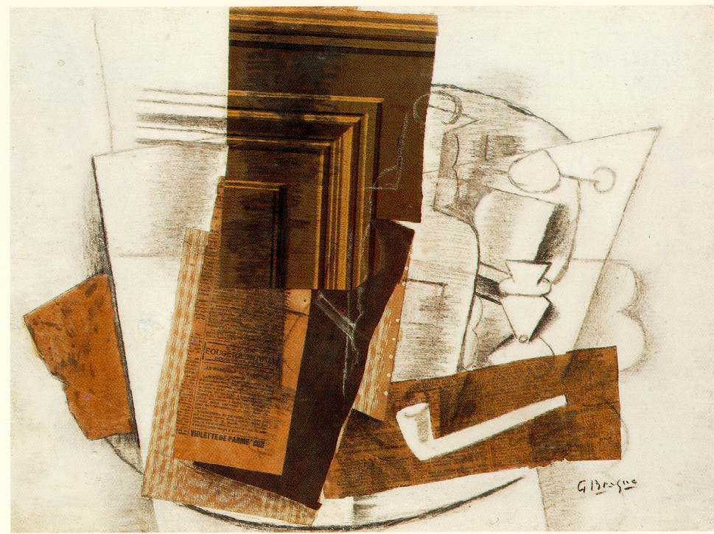
GEORGES BRAQUE
“Bottle, Newspaper, Pipe and Glass” (1913)
[Charcoal and various papers pasted on paper]

Slide 15
GEORGES BRAQUE
“Fruit Dish and Glass” (1912)
[Oil, Sand and Papier Collés]

